Slide 1

Global Superstore Performance Overview
An analytical summary of key business metrics and growth drivers.

Slide 2
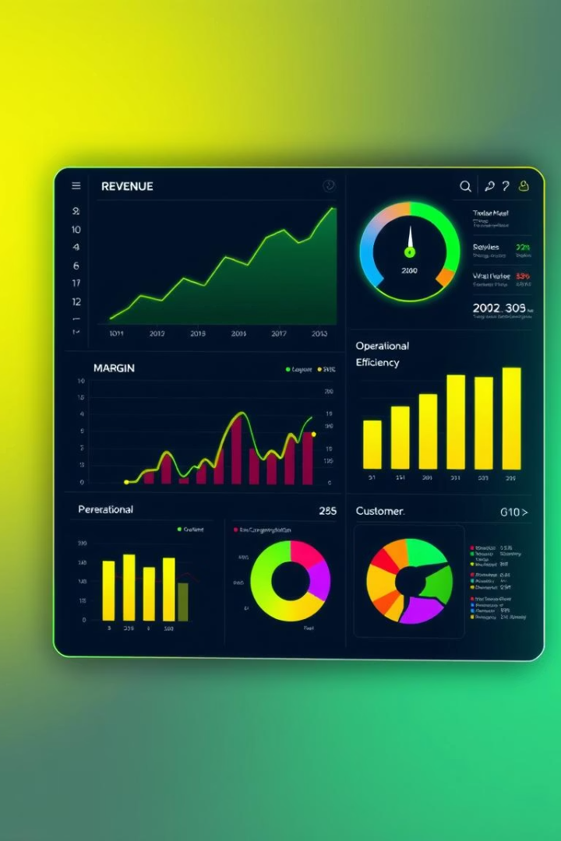
Executive Summary
Revenue Growth
Consistent upward trend over past quarters
Margin Pressure
Discounts reducing profitability significantly
Operational Efficiency
Delivery times vary by region, impacting satisfaction
Customer Segmentation
High-value segments drive majority of profits

Slide 3

Business Goals
Accelerate Revenue Growth
Prioritize high-margin product categories to boost profitability
Enhance Operational Efficiency
Minimize delivery timeframes and reduce associated costs
Optimize Discount Strategies
Maintain a balance between promotional activities and profit margins
Boost Customer Retention
Implement targeted lifecycle management for key customer segments

Slide 4
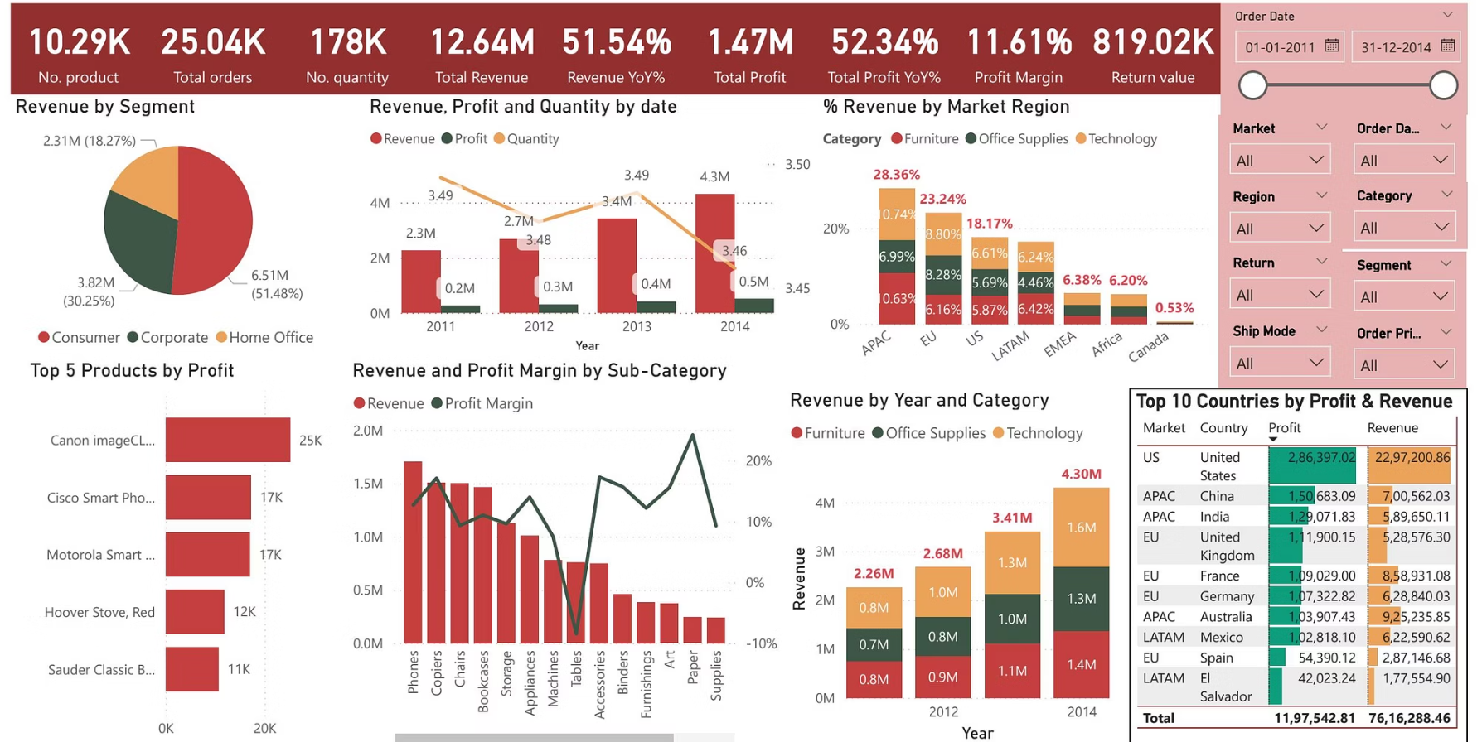
Performance Analysis - Revenue
1
Sale Trend
Over all 87% sales increased
in 4 years
2
Top Categories
Technology Lead Revenue
3
Customer Segments
Repeat Buyers Spend More
4
Opportunity
Target High-Value Customers
Revenue Growth
Discount Impact
52% compound year growth rate
Discounts cut profit margins by 10%
Strong performance in US and Asia markets
Pressure highest in categories with aggressive promotions

Slide 5
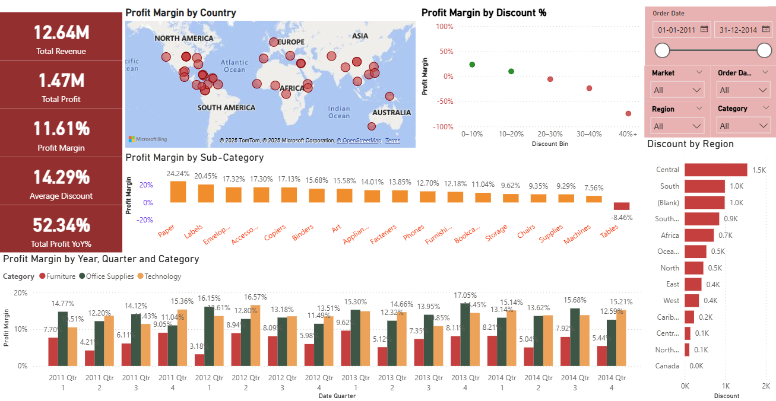
Margin Analysis – Discount Impact & Profitability
1
Product
Profitability
Highest in electronics
And accessories.
2
Regional Margin
Variance
South region has Lowest
Margins
3
Cost Impact
Returns & Logistics reduce
margins
4
Opportunity
Tighten pricing,
Reduce returns
Revenue Growth
Discount Impact
52% compound year growth rate
Discounts cut profit margins by 10%
Strong performance in US and Asia markets
Pressure highest in categories with aggressive promotions

Slide 6
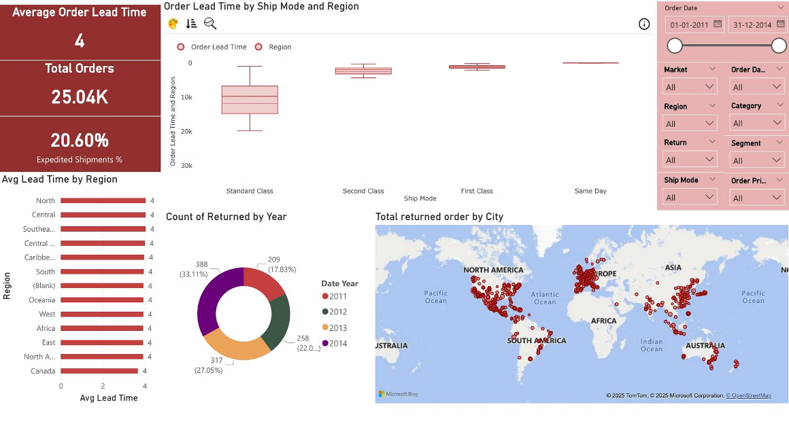
OPERATIONAL EFFICIENCY - Delivery Time & Performance Analysis
1
Order Processing
Average 4 days
2
Shipping Duration
Varies significantly by region
3
Customer Feedback
Delayed delivery correlates with increased returns
4
Improvement Opportunity
Focus on West region for timing improvements

Slide 7
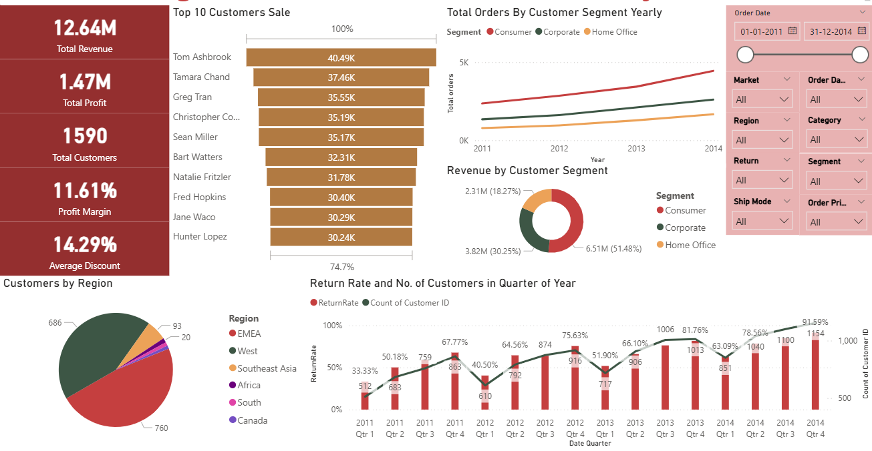
Customer Segmentation & Lifetime Value
Top Segment
High lifetime value, low churn
Growth Segment
Potential to increase
spending with engagement
Churn Risk
Higher return rates observed
in West region

Slide 8

Key Insights
Returns Highest in West Region
Discounts Negatively Affect Profit
Indicates quality or delivery issues
Need balance in promotion strategy
Delivery Delays Impact Customer Retention
Strategic operational improvements needed

Slide 9

Decision Points
1
Reduce Excessive Discounts
Focus on maximizing profitability rather than sales volume
2
Enhance Delivery Operations in West
Allocate resources to lower return rates and improve customer satisfaction

Slide 10





Recommendations
Implement Targeted Discount Policies
Limit discounts on low-margin products
Invest in Logistics for West Region
Improve delivery speed and accuracy
Enhance Customer Engagement
Personalize offers for high-value segments
Monitor Return Drivers
Address product quality and shipping issues

Slide 11

Conclusion & Next Steps
Focus on Profitability and Efficiency
Leverage Data for Customer Targeting
Reduce discount impact, optimize logistics
Drive retention and lifetime value
Track Progress via Dashboard Metrics
Enable continuous improvement

Slide 12
Thank You 😊

